Slide 1
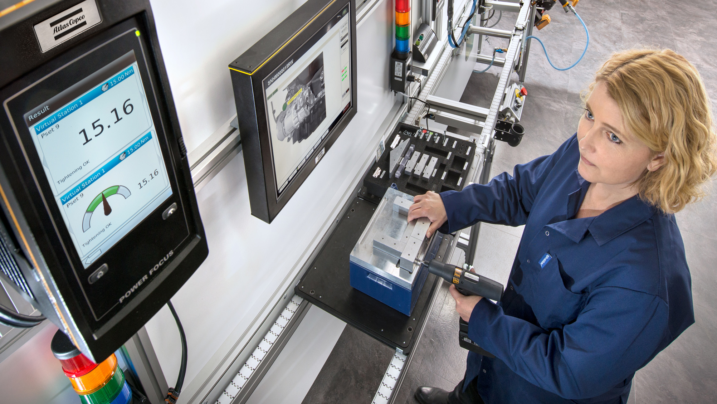
Committed to sustainable productivity
Q4 2014 results
January 29, 2015
Notes:
DISCLAIMER:
The Title slides in this template are not compatible when converted to, for example, Apple devices or uploaded on WebEx. The logo box will be covered by the picture.
To add the logo box on top of the picture, click View, Slide Master and copy the box. Close the Master View and paste the box to the slide. Make sure the text boxes are placed in the front.

Slide 2
Q4 in brief
Record orders received and revenues
2% organic order growth
  Solid growth in the service business
  Strong order intake for industrial tools and assembly systems
  Robust sales of small compressors, low for large
  Mining and construction equipment orders largely unchanged at low level
Positive development in North America and Europe, negative in Asia
Record operating cash flow
Proposed distribution to shareholders of SEK 12.00 per share
  Dividend of SEK 6.00 (5.50) per share to be paid in two installments
  Redemption of SEK 6.00 per share

Slide 3
Q4 figures in summary
Orders received increased 24% to MSEK 24 375, organic growth of 2%
Revenues were MSEK 25 360, organic decline of 3%
Adjusted operating profit was MSEK 4 886 (4 098)
  Reported operating profit was MSEK 4 771 (4 155)
  Items affecting comparability were MSEK -115 (+57)
Adjusted operating margin at 19.3% (19.3)
  Reported operating margin at 18.8% (19.5)
Profit before tax at MSEK 4 436 (3 925)
Basic earnings per share SEK 2.74 (2.39)
Operating cash flow at MSEK 5 083 (2 563)

Slide 4
2014 in summary
Orders received increased 15% to a record of MSEK 93 873
  1% organic order growth, supported by a positive development of the service business
  Higher orders for industrial tools and small- and medium-sized compressors
  Lower orders for large compressors and for mining and construction equipment
Strong North America, weak Asia
Record revenues at MSEK 93 721 and operating cash flow at MSEK 13 869
Operating profit of MSEK 17 015, corresponding to a margin of 18.2%
Acquisition of Edwards vacuum solutions

Slide 5
Orders received - local currency
 | 100 | +13 | +14
Excl. Edwards |  | +3 | +4
 | 30 | +10 | +14
Excl. Edwards |  | +4 | +8
 | 23 | +26 | +23
Excl. Edwards |  | +10 | +9
 | 24 | +16 | +21
Excl. Edwards |  | -6 | -4
 | 10 | -1 | -1
Excl. Edwards |  | -2 | -1
 | 9 | +6 | -3
Excl. Edwards |  | +5 | -4
December 2014
 | 4 | +9 | +18
Excl. Edwards |  | +8 | +10
A | B | C
A = | Share of orders received, year-to-date, %
B = | Year-to-date vs. previous year, %
C = | Last 3 months vs. previous year, %

Slide 6
Organic* order growth per quarter
Atlas Copco Group, continuing operations
* Volume and price

Slide 7
Atlas Copco Group – sales bridge

Slide 8

Atlas Copco Group
16%
45%
27%
12%
January - December 2014

Slide 9
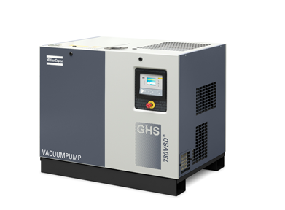
Compressor Technique
Stable equipment orders and growth in service
  Robust demand for small- and medium sized machines
  Soft order intake for larger machines
  Weak demand in Asia
A strong quarter for Edwards vacuum solutions
Adjusted operating margin at 22.2% (22.8)
  Items affecting comparability of MSEK -120
A variable speed drive (VSD) vacuum pump for general industrial applications
Organic revenue growth has not been restated for 2012 and 2013 following the move of Specialty Rental from Compressor Technique to Construction Technique

Slide 10
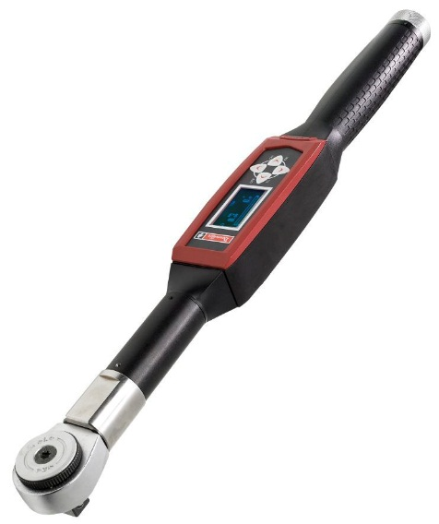
Industrial Technique
Record quarter, with strong growth in Asia
A good start for Henrob
Solid growth of the service business
Operating margin at 22.6% (23.1)
  Supported by volume and currency,
  but diluted by acquisitions
Quality assurance equipment

Slide 11
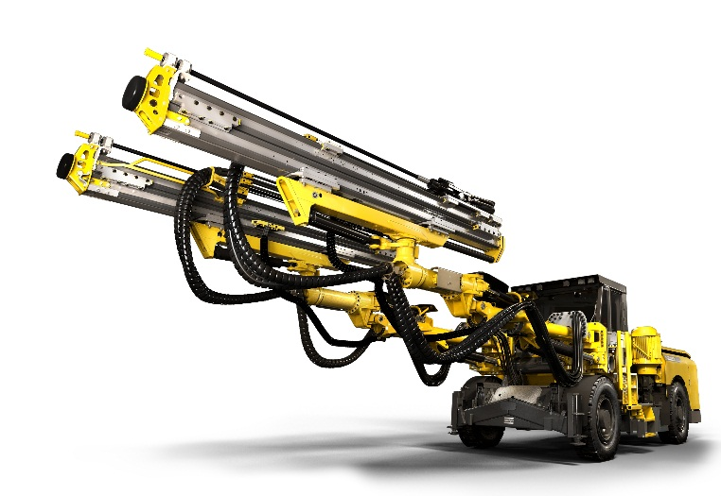
Mining and Rock Excavation Technique
Stable demand for equipment
  Somewhat lower order intake, due to lack of large orders
  Higher order intake in Australia, lower in Asia
Continued growth in service
Further reduction of inventory achieved
Operating margin at 18.5% (17.7)
Upgraded face-drilling rigs for underground mining and tunneling

Slide 12
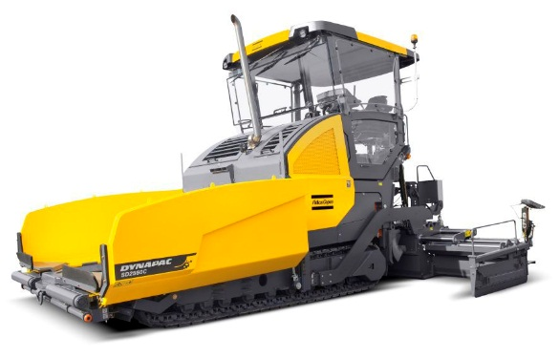
Construction Technique
  Lower orders for portable compressors and road construction equipment, stable for construction and demolition tools
Favorable development for specialty rental
Order growth in Europe and North America, but decrease in China and Brazil
Operating margin at 10.9% (11.1)
Paver with tier IV engine contribute to low emissions and greater fuel savings
Organic revenue growth has not been restated for 2012 and 2013 following the move of Specialty Rental from Compressor Technique to Construction Technique

Slide 13
Group total
2014 vs. 2013

Slide 14
Profit bridge
October – December 2014 vs. 2013

Slide 15
Profit bridge – by business area
October – December 2014 vs. 2013

Slide 16
Profit bridge
January – December 2014 vs. 2013

Slide 17
Profit bridge – by business area
January – December 2014 vs. 2013

Slide 18
Balance sheet

Slide 19
Cash flow

Slide 20
Earnings and dividends
*Dividend and extra dividend for 2014 as proposed by the Board of Directors

Slide 21
Near-term outlook
The overall demand for the Group is expected to increase somewhat.

