Slide 1
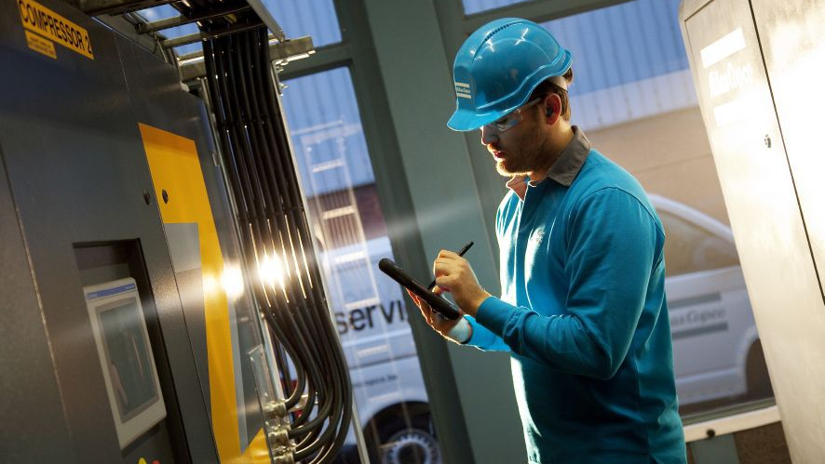
Committed to sustainable productivity
Q2 2014 results
July 16, 2014
Notes:
1. Committed to sustainable productivity
Atlas Copco is an industrial group with world-leading positions in products and services that deliver sustainable productivity.
We are decentralized. Our business activities are conducted through separate operating divisions that work globally.
Wherever we are we strive to ensure reliable, lasting results with responsible use of resources: human, natural and capital.
My name is ……………………………… and I am …………………………………………..
I am grateful to meet you here today to tell our story.

Slide 2
Notes:
2. Committed to sustainable productivity
This is our brand promise. Wherever we are we strive to ensure reliable, lasting results with responsible use of resources: human, natural and capital.

Slide 3
Q2 in brief
Slight sequential improvement in demand
  Sequential order growth for industrial compressors and tools
  Stable order intake for mining equipment
Strong quarter for Edwards, the newly acquired vacuum solutions business
The service business continued to grow
Strong growth in North America

Slide 4
Q2 figures in summary
Orders received increased by 11% to MSEK 23 450, organic growth of 1%
Revenues were MSEK 23 348, organic decline of 3%
Operating profit decreased to MSEK 4 339 (4 533)
Operating margin at 18.6% (20.8)
  Negative effect from lower volumes in Mining and Rock Excavation Technique
Profit before tax at MSEK 4 174 (4 279)
Basic earnings per share SEK 2.64 (2.58)
Operating cash flow at MSEK 2 908 (3 296)

Slide 5
Orders received - local currency
 | 100 | +11 | +11
Excl. Edwards |  | +1 | +2
 | 31 | +7 | +5
Excl. Edwards |  | +1 | -1
 | 22 | +24 | +27
Excl. Edwards |  | +8 | +13
 | 24 | +15 | +18
Excl. Edwards |  | -6 | -3
 | 10 | -3 | -5
Excl. Edwards |  | -3 | -6
 | 9 | +4 | -2
Excl. Edwards |  | +4 | -2
June 2014
 | 4 | +7 | +33
Excl. Edwards |  | +7 | +32
A | B | C
A = | Share of orders received, year-to-date, %
B = | Year-to-date vs. previous year, %
C = | Last 3 months vs. previous year, %

Slide 6
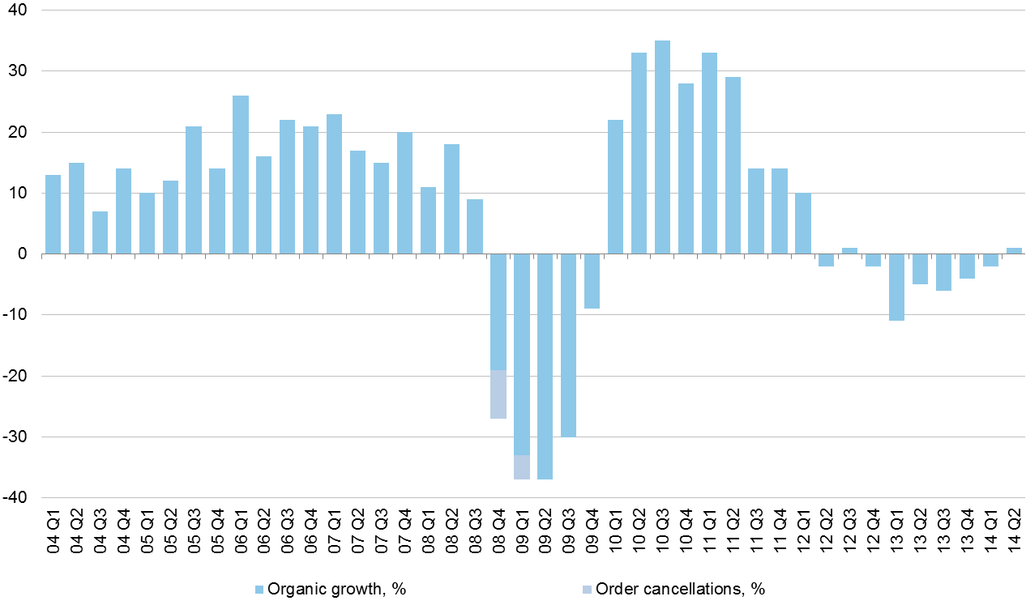
Organic* order growth per quarter
Atlas Copco Group, continuing operations
* Volume and price

Slide 7
Atlas Copco Group – sales bridge

Slide 8

Atlas Copco Group
17%
44%
28%
11%
January - June 2014

Slide 9
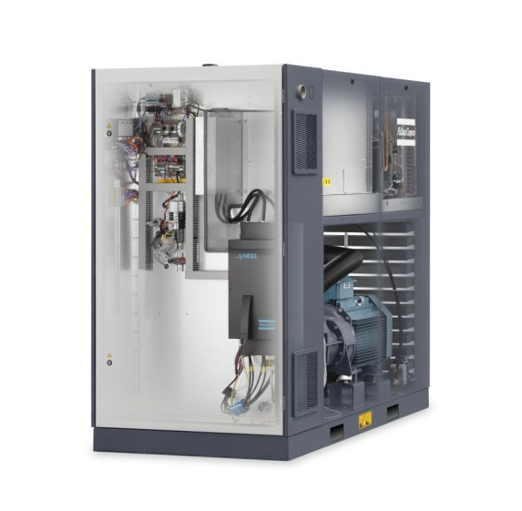
Compressor Technique
Slight improvement for industrial compressors
  Positive in North America and Europe, negative in Asia
Demand for large compressors remain soft
A strong quarter for Edwards vacuum solutions
Service continued to grow
Operating margin at 21.4% (22.8)
Nico Delvaux appointed business area president
A new inverter, designed in-house, that provide increased efficiency
Organic revenue growth has not been restated for 2012 and 2013 following the move of Specialty Rental from Compressor Technique to Construction Technique

Slide 10

Industrial Technique
Strong organic order growth at 7%
  Improved demand from the general industry
  Order intake from the motor vehicle industry remained high
  The service business continued to improve
Operating margin at 22.5% (21.5)
  Supported by volume
Pneumatic impact wrench for use in explosive atmospheres

Slide 11
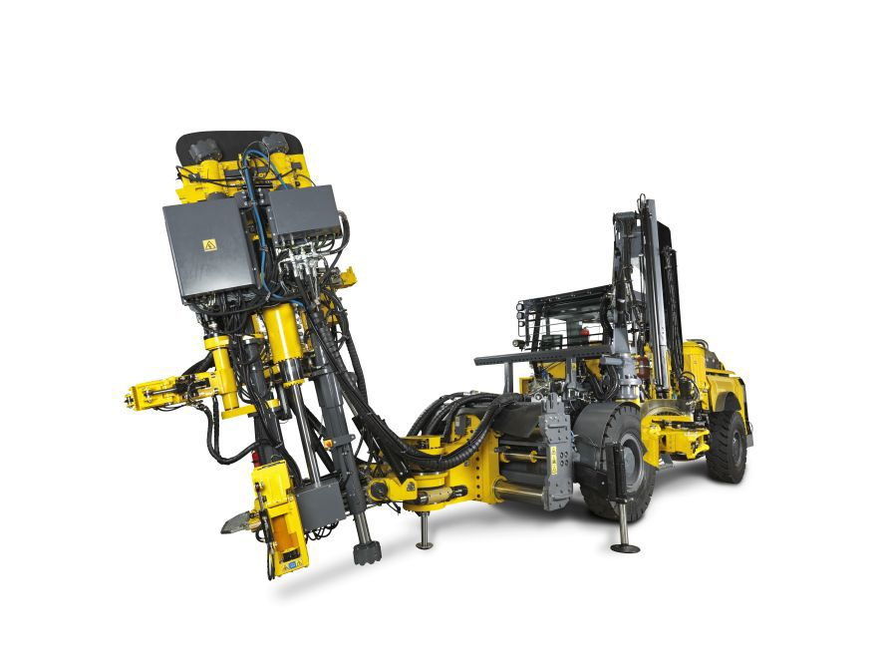
Mining and Rock Excavation Technique
Stable order intake for equipment and service
  Higher in North America and Australia, lower in Asia
Consumables increased sequentially
Operating margin at 18.1% (22.1)
  Margin affected by lower volumes and dilution from acquisitions. Currency had a positive effect.
Further efficiency measures
Mobile and versatile drill rig for opening holes

Slide 12
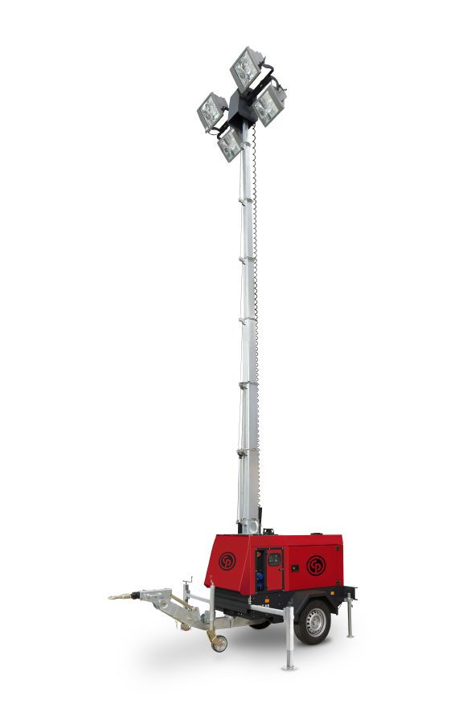
Construction Technique
Mixed order development
  Growth in North America, but negative in Asia
  Increased order intake for road construction equipment and for construction and demolition tools
  Decreased orders for portable energy equipment
  Good development for specialty rental
Operating margin at 13.4% (13.3)
Lighting tower
Organic revenue growth has not been restated for 2012 and 2013 following the move of Specialty Rental from Compressor Technique to Construction Technique

Slide 13
Group total
April – June 2014 vs. 2013

Slide 14
Profit bridge
April – June 2014 vs. 2013

Slide 15
Profit bridge – by business area
April – June 2014 vs. 2013

Slide 16
Balance sheet

Slide 17
Cash flow

Slide 18
Near-term outlook
The overall demand for the Group’s equipment and service is expected to increase somewhat.

